Slide 1


Professional Growth Through
Self-Assessment and
Goal Writing
September 2012

Slide 2

Objectives for today
If we have done our job today, you will:
Draft your self-assessment summary
Draft or revise student learning and professional practice goals and action plans.
Understand how to enter the self-assessment and goals into the EDFS
Understand how to access more resources
Notes:
At this point: ask for a show of hands to identify those at the same stage so they may sit near each other
Brand new to the process
Have written some goals ideas
Have a draft to revise or receive feedback

Slide 3
Resources, Support, Questions, and Feedback
For more information, visit:
  EDFS: http://eval.mybps.org/
  http://educatoreffectiveness.weebly.com
Email questions, comments and feedback to:
  bpsevaluation@boston.k12.ma.us
MA Department of Elementary and Secondary Education (DESE) Evaluation Site:
  http://www.doe.mass.edu/edeval/

Slide 4
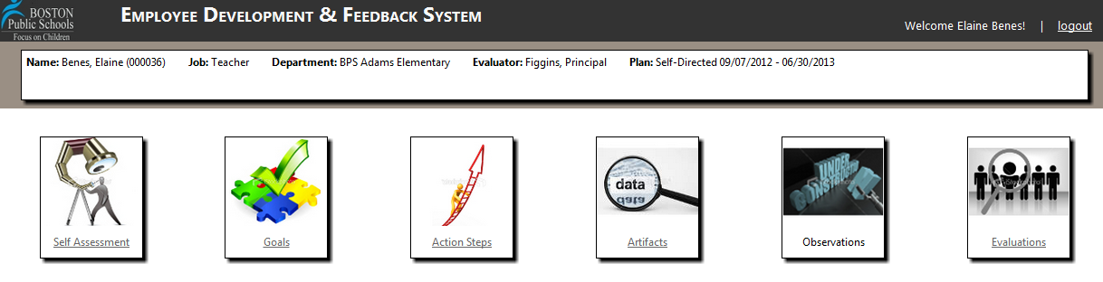
  Educator Feedback and Development System http://eval.mybps.org/
  User ID & Password – Same as MyBPS & The Hub

Slide 5

  http://educatoreffectiveness.weebly.com
For more information, visit:
  EDFS: http://eval.mybps.org/
  http://educatoreffectiveness.weebly.com
Email questions, comments and feedback to:
  bpsevaluation@boston.k12.ma.us
MA Department of Elementary and Secondary Education (DESE) Evaluation Site:
  http://www.doe.mass.edu/edeval/

Slide 6
Today’s Agenda
Brief Overview of Key Changes
        Rubric of Effective Teaching
        5 -Step Cycle
        EDFS Online System
        Ratings & Plans
  Self-Assessment
  Goal Writing
Using EDFS
Notes:
Overview of session
6

Slide 7
Key Change #1:
Rubric for Effective Teaching with 4 Standards
Former Teacher Evaluation (8 Dimensions)
Equity and High Expectations Professionalism Safe, Respectful, Culturally Sensitive and Responsive Learning Communities Partnership with Family and Community Instructional Planning and Implementation: Content Knowledge Monitoring and Assessment of Progress Reflection, Collaboration, and Personal Growth
New Teacher Evaluation (4 Standards)
*Curriculum, Planning & Assessment *Teaching All Students Family & Community Engagement Professional Culture
New Principal/Admin Evaluation (4 Standards)
*Instructional Leadership Management and Operations Family & Community Partnerships Professional Culture
Notes:
*Denotes priority standard(s) on which to focus.
Educators must be rated proficient on these standards in order to earn an overall performance rating of proficient.

Slide 8
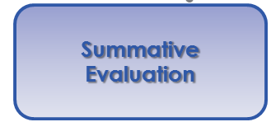
Key Change #2: 5-Step Cycle,
Continuous Learning
Self-Assessment
Analysis, goal-setting & plan development
Implementation of the plan
Formative Assessment/Evaluation
Summative Evaluation
Notes:
5-Step cycle for all educators in licensed positions
8

Slide 9
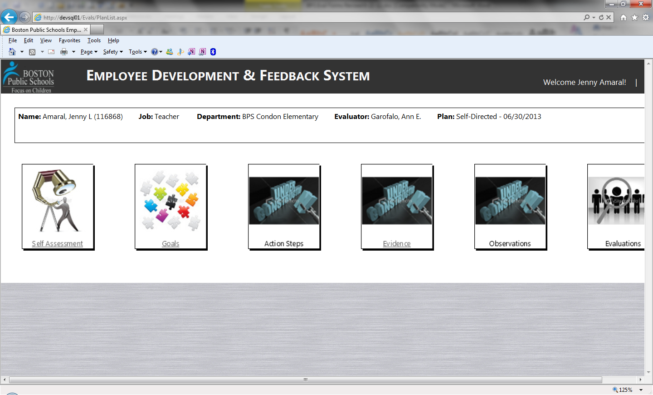
Key Change #3:
Employee Development &
Feedback System (EDFS)

Slide 10
Key Change #4: 4 Rating Categories,
4 Educator Growth Plans
Former categories
Does not meet standards | Does meet standards
Proficient
New categories
Fully and consistently meets the requirements of a standard
Unsatisfactory | Needs Improvement | Proficient | Exemplary
Notes:
Enables us to see variation
Enables us to see excellence: Depends on the way you use these categories
Note: Needs improvement is still within “meets standard”

Slide 11
Educator plans are determined by performance rating and career stage
  Ratings
  Educator Plans
  PTS educators
  Non-PTS educators
Exemplary
Self-Directed Growth Plan
1 or 2 years
Developing Educator Plan
1 year
Proficient
Needs Improvement
Directed-Growth Plan
Up to 1 year
Unsatisfactory
Improvement Plan
30 days – 1 year

Slide 12
Transition year: educator plan is determined by previous performance rating and career stage
  Existing Rating
  Educator Plans
  PTS educators
  Non-PTS educators
Teachers with Overall “Meets Standard”
Self-Directed Growth Plan
1 or 2 years
Developing Educator Plan
1 year
Teachers with 1 Overall “Does Not Meet Standard”
Directed-Growth Plan
Up to 1 year
Teachers with 2+ Overall “Does Not Meets”
Improvement Plan
30 days to 1 year

Slide 13
Goals and Ratings
Progress on Ratings on Overall
(2) Goals (4) Standards Rating
Student Learning
Professional
Practice
Curriculum, Planning and Assessment
Teaching All Students
Family & Community Engagement
Professional Culture
Exemplary
Proficient
Needs Improvement
Unsatisfactory

Slide 14
Today’s Agenda
Brief Overview & Key Changes
        Rubric of Effective Teaching
        5 -Step Cycle
        EDFS Online System
        Ratings & Plans
  Self-Assessment
  Goal Writing
Using EDFS
Notes:
14

Slide 15
Understanding Self-Assessment
What are my strengths and areas for development?
Self-Assessment
Analysis, goal-setting & plan development
Implementation of the plan
Formative Assessment/Evaluation
Summative Evaluation
Notes:
Self assessment consists of analysis of professional practice against the rubrics and analysis of student performance as well as teacher impact

Slide 16
Understanding Self-Assessment
Consider:
School Priorities
District
Rigor through Common Core Shifts Standard I
Using Data & Differentiation Standard II
Family & Community Engagement Standard III
Educator Effectiveness Standard IV
Student learning strengths & needs
Professional practice in relation to the standards outlined in the rubric
Notes:
Self assessment consists of analysis of professional practice against the rubrics and analysis of student performance as well as teacher impact

Slide 17
Teacher Rubric At-A-Glance
Standard I: Curriculum, Planning, and Assessment | Standard II: Teaching All Students | Standard III: Family and Community Engagement | Standard IV: Professional Culture
A. Curriculum and Planning Indicator Subject Matter Knowledge Child and Adolescent Development Rigorous Standards-Based Unit Design Well-Structured Lessons | A. Instruction Indicator Quality of Effort and Work Student Engagement Meeting Diverse Needs | A. Engagement Indicator Parent/Family Engagement | A. Reflection Indicator Reflective Practice Goal Setting B. Professional Growth Indicator Professional Learning and Growth
B. Assessment Indicator Variety of Assessment Methods Adjustments to Practice | B. Assessment Indicator Safe Learning Environment Collaborative Learning Environment Student Motivation | B. Assessment Indicator Learning Expectations Curriculum Support | C. Collaboration Indicator Professional Collaboration
C. Analysis Indicator Analysis and Conclusions Sharing Conclusions With Colleagues Sharing Conclusions With Students | C. Analysis Indicator Respects Differences Maintains Respectful Environment | C. Analysis Indicator Two-Way Communication Culturally Proficient Communication | D. Decision-making Indicator Decision-making E. Shared Responsibility Indicator Shared Responsibility
 | D. Expectations Indicator Clear Expectations High Expectations Access to Knowledge |  | F. Professional Responsibility Indicator Judgment Reliability and Responsibility
Notes:
There are 4 standards and 37 indicators
Can see better on the rubric handout

Slide 18
Self-Assessment in EDFS
Educator submits a summary of strengths and areas of need
Educator will not submit a full rubric used for self-assessment; this aspect of self-assessment is private

Slide 19
Today’s Agenda
Brief Overview & Key Changes
        Rubric of Effective Teaching
        5 -Step Cycle
        EDFS Online System
        Ratings & Plans
  Self-Assessment
  Goal Writing
  Using EDFS
Notes:
Overview of session
19

Slide 20
Understanding Goal Setting
Where do I need to grow this year? Where do I want my students to grow this year?
Self-Assessment
Analysis, goal-setting & plan development
Implementation of the plan
Formative Assessment/Evaluation
Summative Evaluation

Slide 21
Proposing and Setting Goals
Each educator is responsible for at least:
  One goal for student learning, growth and achievement
      Using baseline student data
  One goal for professional practice
      Written to support the achievement of the student learning goal
      Linked to an element of the rubric
Consider team, grade, or department goals
Educator proposes by October 1st, supervisor approves
Notes:
Educators will be pursuing at least one goal related to their professional practice as well as at least one directly related to student learning.
Educators and their evaluators consider team goals. We think team goals – in the hands of proficient and exemplary teachers and administrators especially – will help support and sustain the professional learning communities that research increasingly tells us are critical to continuous improvement at both the individual and school level.
Ultimately, under the regulations, the evaluator makes the call as to the goals the educator pursues

Slide 22
Attributes of a Strong Goal
Make sure the goal
is written clearly enough so that both you and your evaluator can determine your degree of success in meeting the goal!
Specific
Measurable
Attainable
Results-Focused
Time-bound
Notes:
SMA in goal statement, RT in action plan
What does it really look like for a goal to be strategic? To be actionable?

Slide 23
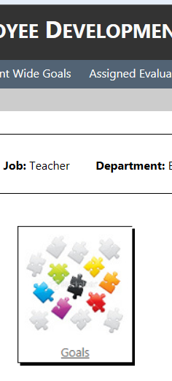
Goal Proposal in EDFS
Propose one student learning and one professional practice goal
Evaluator will accept or return goals for revision
Templates are included in the EDFS to support goal-writing

Slide 24
Self-Assessment Activity
Self-Assessment is an opportunity for personal reflection on student learning and practice.
Directions:
Complete the Self-Assessment worksheet
-Review district priorities
-Consider school priorities
-Consider student learning needs
Notes:
Reminder: sit next to someone at the same stage in the process
New to this
Some fleshed out ideas and topics
A written draft looking for feedback for revision

Slide 25
Writing Goals Activity
Directions:
Use the Goal Writing worksheet to begin writing student learning and professional practice goals.
To aid your thinking, use the page of sample goals which are linked to a district priority and an element of the rubric.
Complete the Action Plan Development worksheet to identify specific steps to reach.

Slide 26
Goals and Ratings
Progress on Ratings on Overall
(2) Goals (4) Standards Rating
Student Learning
Professional
Practice
Curriculum, Planning and Assessment
Teaching All Students
Family & Community Engagement
Professional Culture
Exemplary
Proficient
Needs Improvement
Unsatisfactory

Slide 27
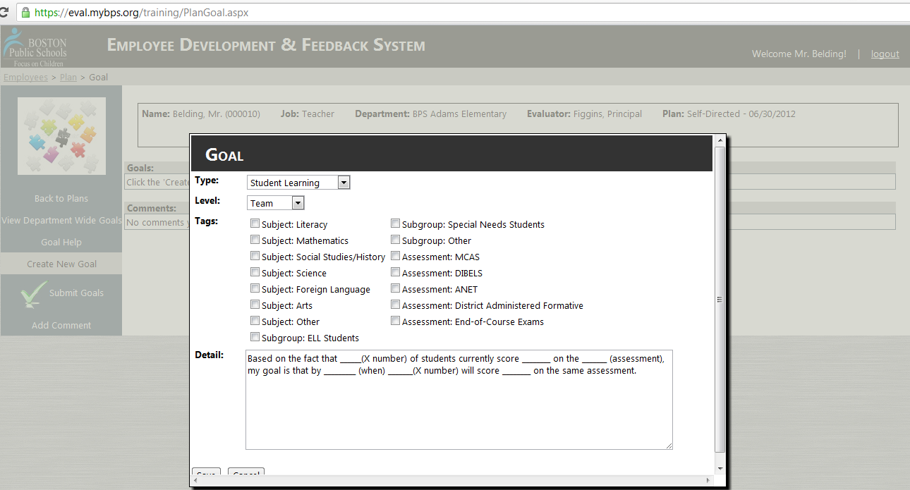
EDFS: Student Learning Goal Proposal
27

Slide 28
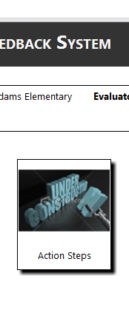
EDFS: Action Steps and Plan Development
Each goal must have action steps to support educators’ completion of the goal
The action steps develop the plan into actionable steps including
  Actions;
  Supports or resources required;
  Timeline and frequency.
These steps will also be entered into the EDFS
28

Slide 29
Today’s Agenda
Brief Overview & Key Changes
        Rubric of Effective Teaching
        5 -Step Cycle
        EDFS Online System
        Ratings & Plans
  Self-Assessment
  Goal Writing
  Using EDFS
Notes:
Overview of session
29

Slide 30
Employee Feedback and Development System
Log on to:
http://eval.mybps.org/

Slide 31
Resources, Support, Questions, and Feedback
For more information, visit:
  EDFS: http://eval.mybps.org/
  http://educatoreffectiveness.weebly.com
Email questions, comments and feedback to:
  bpsevaluation@boston.k12.ma.us
MA Department of Elementary and Secondary Education (DESE) Evaluation Site:
  http://www.doe.mass.edu/edeval/

Slide 32
Office of Educator Effectiveness
Ross Wilson, Assistant Superintendent for Educator Effectiveness
Jared Joiner, Implementation Specialist
Emily Kalejs Qazilbash, Implementation Specialist
Angela Rubenstein, Implementation Specialist
Kris Taylor, Implementation Specialist
Jenna Costin, EDFS On-line System Coordinator

Slide 33
Have we met our goals for today?
If we have done our job today, you:
Have started a draft of your self-assessment summary
Have started to write or revise student learning and professional practice goals
Understand how to enter the self-assessment and goals into the EDFS
Notes:
Intended outcomes for today
Continued support throughout the year

