Slide 1


Creating & Implementing Your Plan
October 2012

Slide 2

Objectives for today
If we have done our job today, you will:
Draft your action steps
Understand how to enter action steps into the EDFS
Identify types of evidence that you will use to document
  progress toward goals
  proficiency in 4 standards
Understand how to upload evidence into the EDFS
Notes:
At this point: ask for a show of hands to identify those at the same stage so they may sit near each other
Brand new to the process
Have written some goals ideas
Have a draft to revise or receive feedback

Slide 3

  http://educatoreffectiveness.weebly.com
For more information, visit:
  EDFS: http://eval.mybps.org/
  http://educatoreffectiveness.weebly.com
Email questions, comments and feedback to:
  bpsevaluation@boston.k12.ma.us
MA Department of Elementary and Secondary Education (DESE) Evaluation Site:
  http://www.doe.mass.edu/edeval/

Slide 4
Norms
How can we, as a team of adults looking to support and help children learn, work together most effectively today?
  Respect diversity of perspectives
  Engage in active listening
  Assume best intentions
  Provide safety and confidentiality
  Know that there are “no dumb questions”
  Others?
Notes:
4

Slide 5
Introductions: Turn and Talk
Name
School
What would you like to improve upon this school year?
Notes:
Introduce yourself to someone nearby who you don’t know
Facilitators introduce themselves
5

Slide 6
Self-Assessment Data: Strengths
Notes:
Introduce yourself to someone nearby who you don’t know
Facilitators introduce themselves
6

Slide 7
Self-Assessment Data: Areas for Growth
Notes:
Introduce yourself to someone nearby who you don’t know
Facilitators introduce themselves
7

Slide 8
Plan Development & Implementation
Self-Assessment
Analysis, goal-setting & plan development
Implementation of the plan
Formative Assessment/Evaluation
Summative Evaluation

Slide 9
Today’s Agenda
Overview of the Evaluation Cycle
        Goal & Action Plan Development
        Evidence: Observations & Artifacts
        Formative Assessment & Summative Evaluation
  Developing Your Action Plan
        Entering Steps in EDFS
  Using Artifacts
        Uploading in EDFS
Notes:
Overview of session
9

Slide 10
Goal & Action Plan Development
Each goal requires an action plan
  If goals are related, only one action plan is needed
  Team goals can have team action plans
  Action plans submitted for approval just like goals
Both goals and action plans must be approved by your evaluator by Nov 1
Notes:
Overview of session
10

Slide 11
Evidence: Observations & Artifacts
Evidence collected to show:
  Proficiency in 4 standards
  Progress toward goals
Evaluators & educators both collect
  Evaluators mainly through observations
  Educators through artifacts
Notes:
Overview of session
11

Slide 12
Observations
Opportunity for evaluators to
  gather data
  provide feedback
May include
  Classroom visits
  Learning Walks or Instructional Rounds
  Team or parent meetings
Feedback in EDFS within 5 school days
  Conversations also encouraged
Notes:
Overview of session
12

Slide 13
Contractual Observation Requirements
Type of Plan | Announced Observations | Unannounced Observations
 | At least 30 min (suggested) Post conference Feedback in EDFS in 5 days | At least 10-15 min (suggested) Feedback in EDFS in 5 days
Self-Directed | None Required | 1
Directed | None Required | 2
Improvement | 1 | 2 for plans less than 6 months 4 for plans more than 6 months
Developing | 1 | 4
Please note: These are minimum requirements, best practice suggests 8-10 points of contact during the evaluation cycle

Slide 14
Artifacts
Opportunity for educators to document
  progress on goals & performance in standards
  evidence not captured during observations
May include
  Lesson plans
  Student work
  Data analysis
Upload electronic files on EDFS
  Can keep a binder & provide descriptions in EDFS
Notes:
Needs to be digital representation on EDFS, but can maintain binder for items difficult to scan – moving towards paperless, but for transition this is ok
14

Slide 15
Formative Assessment & Summative Evaluation
Ratings on:
  Proficiency in each standard
  Progress toward each goal
  Overall rating based on professional
  judgment of standards AND goals
Meetings
  Upon request of educator or evaluator
  Required for ratings of NI or Unsatisfactory
Sign off through EDFS
Notes:
Overview of session
15

Slide 16
Formative Assessment & Summative Evaluation
Formative Assessment
  Reviews strengths, areas for improvement, and progress toward goals
  Should be at midpoint of cycle, but may occur at any time
  Can lead to a change in plan
Summative Evaluation
  By May 15 for one-year plans
  Overall rating determines the next plan
  Prescriptions for standards rated less than proficient
Notes:
Overview of session
16

Slide 17
Today’s Agenda
Overview of the Evaluation Cycle
        Goal & Action Plan Development
        Evidence: Observations & Artifacts
        Formative Assessment & Summative Evaluation
  Developing Your Action Plan
        Entering Steps in EDFS
  Using Artifacts
        Uploading in EDFS
Notes:
Overview of session
17

Slide 18
Developing Your Action Plan
An action plan…
  Details 3-5 action steps per goal
  Includes a timeframe or frequency for each step
  Identifies supports / resources necessary for each step
Think about…
  Benchmark assessments
  Potential artifacts
  Possible roadblocks
Notes:
Overview of session
18

Slide 19

Developing Your Action Plan
After writing your goals,
click on the “Action Steps” icon.
Both goals and action plans must be
approved by November 1.
Notes:
Overview of session
19

Slide 20
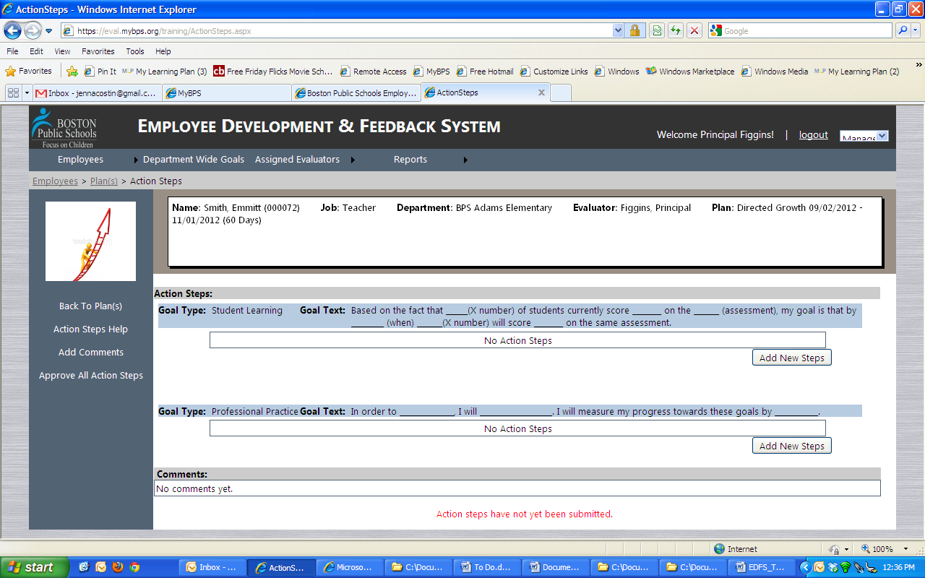
Developing Your Action Plan
When you click on the icon,
you will see your goals.
Select “Add New Steps.”
Notes:
Overview of session
20

Slide 21
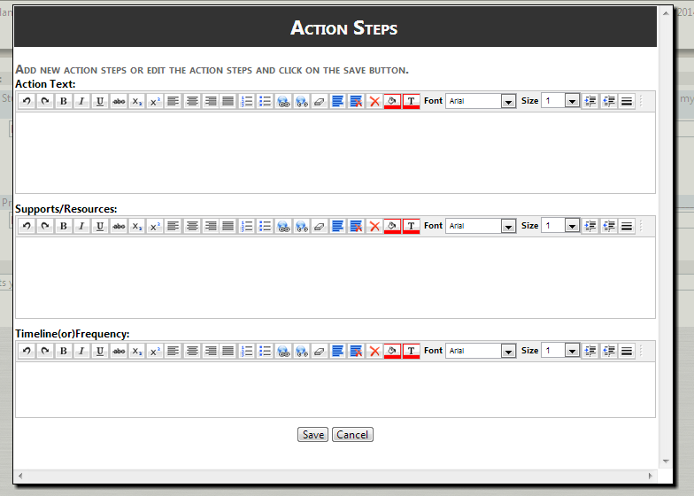
Developing Your Action Plan
  For each step, identify:
Action
Supports
Timeline
Notes:
Overview of session
21

Slide 22
Developing Your Action Plan
Action steps may include:
  Specific adjustments to practice
  Measures of progress toward goals
  Professional learning opportunities
  Previous prescriptions
Evaluators may assign action steps to educators on Improvement / Directed Growth plans
Notes:
Overview of session
22

Slide 23
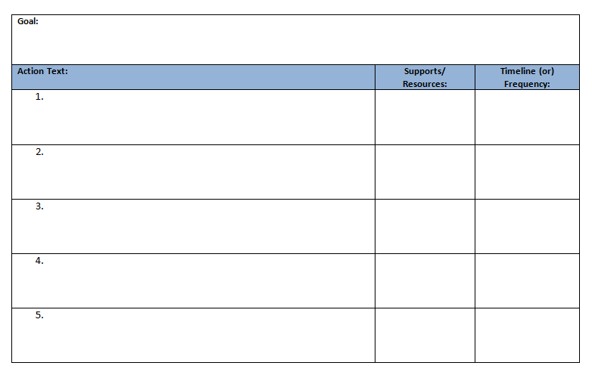
Developing Your Action Plan
  Use the Action Planning Worksheet to develop each step before entering them in EDFS
Notes:
Overview of session
23

Slide 24
Today’s Agenda
Overview of the Evaluation Cycle
        Goal & Action Plan Development
        Evidence: Observations & Artifacts
        Formative Assessment & Summative Evaluation
  Developing Your Action Plan
        Entering Steps in EDFS
  Using Artifacts
        Uploading in EDFS
Notes:
Overview of session
24

Slide 25
Overall Ratings
Progress on Ratings on Overall
Goals 4 Standards Rating
Educators are responsible for providing evidence for all standards and goals
Student Learning
Professional Practice
I. Curriculum, Planning
and Assessment
II. Teaching All Students
III. Family & Community
Engagement
IV. Professional Culture
Exemplary
Proficient
Needs Improvement
Unsatisfactory

Slide 26
Possible Artifacts
Standard I | Standard II | Standard III | Standard IV | Student Learning Goal | Professional Practice Goal
Unit & lesson plans | Modified plans & materials | Newsletters | Thoughtful self-assessment & goals | Student work samples | Records of/ Reflections on practice
Student work Data analysis
3-4 artifacts per standard/goal recommended
An artifact can be evidence for multiple
standards/goals

Slide 27
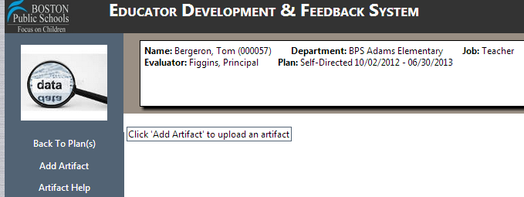
Uploading onto EDFS
Step 1:
Step 2:
Select the “Artifacts” icon
and you will get this screen:

Slide 28
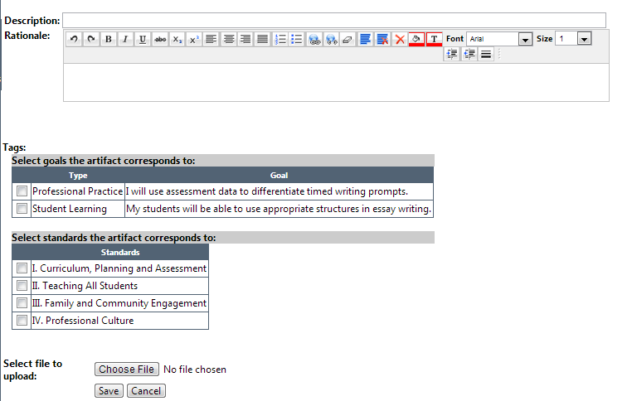
Uploading onto EDFS
When you click “Add Artifacts,” you will get this:
Description
(what is it?)
Rationale
(why this?)
Tags
(which goals
& standards?)
Choose
File & Save

Slide 29
To Do
Today…
Finalize your goals & work on action steps
Next steps…
Finalize & submit goals
Finalize & submit action plans
Upload artifacts

Slide 30
Resources, Support, Questions, and Feedback
For more information, visit:
  EDFS: http://eval.mybps.org/
  http://educatoreffectiveness.weebly.com
Email questions, comments and feedback to:
  bpsevaluation@boston.k12.ma.us
MA Department of Elementary and Secondary Education (DESE) Evaluation Site:
  http://www.doe.mass.edu/edeval/

Slide 31
Office of Educator Effectiveness
Ross Wilson, Assistant Superintendent for Educator Effectiveness
Jared Joiner, Implementation Specialist
Emily Kalejs Qazilbash, Implementation Specialist
Angela Rubenstein, Implementation Specialist
Kris Taylor, Implementation Specialist
Jenna Costin, EDFS On-line System Coordinator

Slide 32
Have we met our goals for today?
If we have done our job today, you:
Have started a draft of your action steps
Understand how to enter action steps into the EDFS
Have started to identify types of evidence that you will use
Understand how to upload evidence into the EDFS
Notes:
At this point: ask for a show of hands to identify those at the same stage so they may sit near each other
Brand new to the process
Have written some goals ideas
Have a draft to revise or receive feedback

