Slide 1
Formative Assessments and Observations on EDFS

Slide 2
Select the teacher for whom you would like to submit a formative assessment, then select the Evaluations icon
Formative Assessment

Slide 3
Select Start New Evaluation, then the type of evaluation / assessment
Formative Assessment
Step 1
Step 2

Slide 4
All sections of the Formative Assessment will appear: Goals, Standards, Prescriptions, Comments, Overall Rating, Sign-Off
Formative Assessment

Slide 5
Rate each goal and list your rationale: Exceeded, Met, Significant Progress, Some Progress, Did Not Meet
Formative Assessment: Goals

Slide 6
*Rate each standard and list your rationale *Observations/Evidence Filters into eval
Formative Assessment: Standards

Slide 7
EDFS will ONLY ask you to write a prescription if you have rated the educator Unsatisfactory or Needs Improvement in any of the four standards.
Formative Assessment: Prescriptions

Slide 8
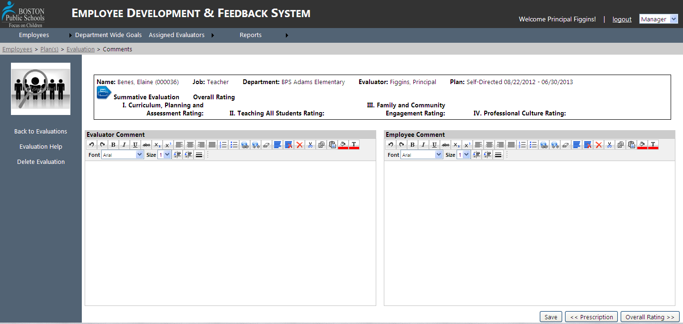
Opportunity for you to add comments now, or for Educator to respond to Evaluation after
Formative Assessment: Comments

Slide 9
Review Goals and Standards Ratings and choose Overall Rating
Formative Assessment: Overall Rating

Slide 10
Step 2: Type your name and Submit Signature
Formative Assessment: Sign Off
Step 1: Note whether you would like to end the current plan

Slide 11
Formative Assessment: Questions
How prepared do you feel to make an informed rating on your teachers' proficiency in the 4 standards?
I. Curriculum, Planning, & Assessment
II. Teaching All Students
III. Family & Community Engagement
IV. Professional Culture

Slide 12
Select the employee you are observing
Observations

Slide 13
Select the Observation icon
Observations

Slide 14
Select New Observation
Observation Form

Slide 15
1) Enter basic information about the Observation: Date, time, type, and subject observed
Observation Form

Slide 16
* Add Evidence/Feedback
Observation Form

Slide 17
* Choose the Standard/Indicator/Element before, during, or after observation when editing.
Observation Form

Slide 18
*Add more Evidence/Feedback text boxes as you are observing and choose Indicator/Element during or after observing
Observation Form

Slide 19
* SAVE the observation to edit again later, or Release observation to allow the educator to view *Note: Must give Educators feedback within 5 days of observing
Observation Form

Slide 20
Focusing on specific Indicators? Set your Observation Default Indicators! Located at the top of your EDFS page
Observation Defaults

Slide 21
Choose which indicators you want to appear on your Observation Page
Observation Defaults

Slide 22
Giving Feedback :
Consider this:
Actionable
Realistic
Specific
Growth oriented

Slide 23
Observation Questions
How do you personalize feedback for the various educators you work with?
Different levels of experience
Different personalities
Different strengths and needs

