Slide 1
Making Evaluation Work at Your School
Leadership Institute 2012

Slide 2
Rubric for Effective Teaching with 4 Standards
Former Teacher Evaluation (8 Dimensions)
Equity and High Expectations Professionalism Safe, Respectful, Culturally Sensitive and Responsive Learning Communities Partnership with Family and Community Instructional Planning and Implementation: Content Knowledge Monitoring and Assessment of Progress Reflection, Collaboration, and Personal Growth
New Teacher Evaluation (4 Standards)
*Curriculum, Planning & Assessment *Teaching All Students Family & Community Engagement Professional Culture
New Principal/Admin Evaluation (4 Standards)
*Instructional Leadership Management and Operations Family & Community Partnerships Professional Culture
Notes:
*Denotes priority standard(s) on which to focus.
Educators must be rated proficient on these standards in order to earn an overall performance rating of proficient.

Slide 3
Teacher Rubric At-A-Glance
Standard I: Curriculum, Planning, and Assessment | Standard II: Teaching All Students | Standard III: Family and Community Engagement | Standard IV: Professional Culture
A. Curriculum and Planning Indicator Subject Matter Knowledge Child and Adolescent Development Rigorous Standards-Based Design Well-Structured Lessons | A. Instruction Indicator Quality of Effort and Work Student Engagement Meeting Diverse Needs | A. Engagement Indicator Parent/Family Engagement | A. Reflection Indicator Reflective Practice Goal Setting B. Professional Growth Indicator Professional Learning and Growth
B. Assessment Indicator Variety of Assessment Methods Adjustments to Practice | B. Assessment Indicator Safe Learning Environment Collaborative Learning Environment Student Motivation | B. Assessment Indicator Learning Expectations Curriculum Support | C. Collaboration Indicator Professional Collaboration
C. Analysis Indicator Analysis and Conclusions Sharing Conclusions With Colleagues Sharing Conclusions With Students | C. Analysis Indicator Respects Differences Maintains Respectful Environment | C. Analysis Indicator Two-Way Communication Culturally Proficient Communication | D. Decision-making Indicator Decision-making E. Shared Responsibility Indicator Shared Responsibility
 | D. Expectations Indicator Clear Expectations High Expectations Access to Knowledge |  | F. Professional Responsibility Indicator Judgment Reliability and Responsibility
Notes:
There are 4 standards and 37 indicators
Can see better on the rubric handout

Slide 4
Standard
Indicator
Element
Notes:
Standards I through IV
Indicators for each standard
Sub-indicators/Dimensions for each indicator
Performance levels articulated
Developmental v. degree?

Slide 5
The Overall Rating
There are 4 standards
Teachers are assessed for proficiency in each standard
Everyone sets 2 goals:
A goal for student learning
tied to data
A goal for professional practice
tied to rubric
will help you accomplish your student learning goal
Notes:
Overview of session
5

Slide 6
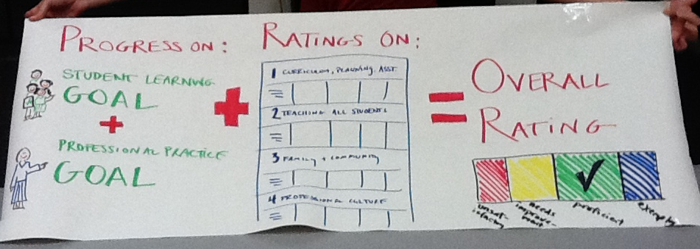
The Overall Rating
At least one SL and one PP goal
+
Ratings on the Four Standards of the Rubric
Notes:
Overview of session
6

Slide 7
School-wide goals & priorities should guide the
Five Step Evaluation System Cycle
School-wide Analysis & Goal-Setting
Self-Assessment
Analysis, goal-setting & plan development
Implementation of the plan
Formative Assessment/Evaluation
Summative Evaluation
Notes:
7

Slide 8
Your Context
District
District-level Data Trend
School
School-level Data Trends
Team
Previous/current year Data Trends
WSIP and School Priority Areas
District Priority Areas
Areas of Strength/Growth
Individual
Student Data
Areas of Strength/Growth
Notes:
What surprised you?
How did the rubric work?
What are some of the behaviors you came up with?

Slide 9
District priorities reflected in the teacher rubric:
District Priority | Element of rubric
Professional Growth and Evaluation | Goal Setting (IV-A-2)
Using Data to Differentiate Instruction | Adjustments to Practice (I-B-2) Access to Knowledge (II-D-3)
Increasing Academic Rigor | Well-Structured Lessons (I-A-4)
Engaging Families, Community and Partners | Parent/Family Engagement (III-A-1) and Two-Way Communication (III-C-1)
Notes:
9.15 -9.25
This slide shows district priorities (with corresponding priority elements) ask participants to share current practices in their school which are linked to these priorities
Notes: Priority elements reflect academic priorities, and PD and supports will be provided around these elements. These elements should be used in making decisions relative to an overall rating on a standard. Other elements may also be used that are relative to a school / team goals when rating a standard.
Use these priority elements when helping people to plan to do their self-assessment.
The Acceleration Agenda should guide school goals and targets and should guide team and individual goals and targets. Professional Practice goals should be related to the priority elements on the rubric.
They should reflect in groups about this question on the bottom of the screen.
The district has 4 priorities :
data analysis
common core standards
differentiated instruction ---- there is a mistake in the slide. Note that participants should cross off cultural proficiency and instead write “differentiated instruction.”
teacher effectiveness

Slide 10
Getting started at your school
Identify your priority elements for your school
at least one in each of the 4 standards
Identify the behaviors you expect to see with teachers
Then, ask educators to:
Self-assess
Set goals
Focus on student outcomes
Note: If an educator is less than proficient, don’t look ONLY at these priorities

Slide 11
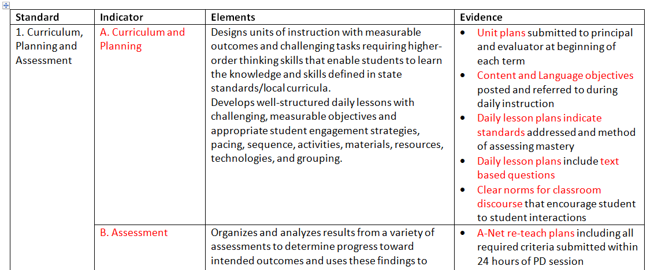
Example from the Edison

Slide 12
District priorities reflected in the administrator rubric:
District Priority | Element of teacher rubric | Element of admin rubric
Professional Growth and Evaluation | Goal Setting (IV-A-2) | Educator Goals (I-D-1 ) Observation & Feedback (I-D-2)
Using Data to Differentiate Instruction | Adjustments to Practice (I-B-2) Access to Knowledge (II-D-3) | Adjustments to Practice (I-C-2) Diverse Learners’ Needs (I-B-3)
Increasing Academic Rigor | Well-Structured Lessons (I-A-4) | Lesson Development Support (I-A-2)
Engaging Families, Community and Partners | Parent/Family Engagement (III-A-1) Two-Way Communication (III-C-1) | Parent/Family Engagement (III-A-1) Two-Way Communication (III-C-1)
Notes:
9.15 -9.25
This slide shows district priorities (with corresponding priority elements) ask participants to share current practices in their school which are linked to these priorities
Notes: Priority elements reflect academic priorities, and PD and supports will be provided around these elements. These elements should be used in making decisions relative to an overall rating on a standard. Other elements may also be used that are relative to a school / team goals when rating a standard.
Use these priority elements when helping people to plan to do their self-assessment.
The Acceleration Agenda should guide school goals and targets and should guide team and individual goals and targets. Professional Practice goals should be related to the priority elements on the rubric.
They should reflect in groups about this question on the bottom of the screen.
The district has 4 priorities :
data analysis
common core standards
differentiated instruction ---- there is a mistake in the slide. Note that participants should cross off cultural proficiency and instead write “differentiated instruction.”
teacher effectiveness

Slide 13
Writing your own professional practice goal
Standard I: Instructional Leadership. The education leader promotes the learning and growth of all students and the success of all staff by cultivating a shared vision that makes powerful teaching and learning the central focus of schooling.
Indicator I-A. Curriculum: Ensures that all teachers design effective and rigorous standards-based units of instruction consisting of well-structured lessons with measurable outcomes.
I-A-2. Lesson Development Support | Proficient: | Supports educators to develop well-structured lessons with challenging, measurable objectives and appropriate student engagement strategies, pacing, sequence, activities, materials, technologies, and grouping.
Notes:
9.15 -9.25
This slide shows district priorities (with corresponding priority elements) ask participants to share current practices in their school which are linked to these priorities
Notes: Priority elements reflect academic priorities, and PD and supports will be provided around these elements. These elements should be used in making decisions relative to an overall rating on a standard. Other elements may also be used that are relative to a school / team goals when rating a standard.
Use these priority elements when helping people to plan to do their self-assessment.
The Acceleration Agenda should guide school goals and targets and should guide team and individual goals and targets. Professional Practice goals should be related to the priority elements on the rubric.
They should reflect in groups about this question on the bottom of the screen.
The district has 4 priorities :
data analysis
common core standards
differentiated instruction ---- there is a mistake in the slide. Note that participants should cross off cultural proficiency and instead write “differentiated instruction.”
teacher effectiveness

Slide 14
Coming Soon
Contract information
Resources
Webinar

Slide 15
Resources, Support, Questions, and Feedback
For more information, visit:
http://connect.mybps.org/groups/effectiveteaching/
http://educatoreffectiveness.weebly.com
Email questions, comments and feedback to:
bpsevaluation@boston.k12.ma.us
MA Department of Elementary and Secondary Education (DESE) Evaluation Site:
http://www.doe.mass.edu/edeval/

