Slide 1

Supporting Effective Teaching through Educator Performance Evaluation:
Goal-Writing
Summer Institute 2012

Slide 2
Today’s Agenda
Welcome & Overview
The District Context
  Self-Assessment
  Proposing Goals
  Action Plan Development
  Q & A
Notes:
Overview of session
2

Slide 3

If we have done our job today, you will:
Be familiar with how the on-line system will work;
Gain insight into the role of self-assessment in the evaluation process and understand how a thoughtful self-assessment practice sets the stage for a focused evaluation process;
Begin to set personal SMART goals;
Develop an Action Plan;
Know next steps and resources.
Notes:
Intended outcomes for today
Continued support throughout the year

Slide 4
Introductions
With elbow partners, share your
Name
School
Why you signed up for this session
Notes:
Introduce yourself to someone nearby who you don’t know
Facilitators introduce themselves
4

Slide 5
What we’ve heard about the new eval system:
Concerns | Opportunities
It’s a lot of work for both teachers and evaluators. | Evaluators will provide feedback and support on teaching practice.
It emphasizes “needs improvement” over exemplary teaching – it seems like you’re telling us that not everyone is “exemplary.” | Monitoring progress through goal-setting provides a chance to concretely see what my students have accomplished.
It’s hard to measure how much students have learned in my class in order to judge if I’ve met my goals. | Teachers have a voice in providing evidence about their performance.
The rubric is vague in places. | Much of the work that teachers are already doing is captured by this new system.
It seems much more geared toward teachers and not specialized instructional support personnel. | The new evaluation teacher and administrator rubrics and systems are aligned.

Slide 6
Norms
How can we, as a team of adults looking to support and help children learn, work together most effectively today?
  Respect diversity of perspectives
  Engage in active listening
  Assume best intentions
  Provide safety and confidentiality
  Know that there are “no dumb questions”
  Others?
Notes:
This new system will help clarify and define what is effective teaching in BPS
This new system will help BPS focus and provide better support for effective teaching so that student learning results improve
You will receive the training and support you need to make the most of the new evaluation process
You will share your questions, comments, feedback, and suggestions with us, throughout the year
6

Slide 7
Key Change #1:
Rubric for Effective Teaching: with 4 Standards
Former Teacher Evaluation (8 Dimensions)
Equity and High Expectations Professionalism Safe, Respectful, Culturally Sensitive and Responsive Learning Communities Partnership with Family and Community Instructional Planning and Implementation: Content Knowledge Monitoring and Assessment of Progress Reflection, Collaboration, and Personal Growth
New Teacher Evaluation (4 Standards)
*Curriculum, Planning & Assessment *Teaching All Students Family & Community Engagement Professional Culture
New Principal/Admin Evaluation (4 Standards)
*Instructional Leadership Management and Operations Family & Community Partnerships Professional Culture
Notes:
* Denotes priority standard(s) on which to focus.
Educators must be rated proficient on these standards in order to earn an overall performance rating of proficient.

Slide 8
Standard
Indicator
Element
Notes:
Standards I through IV
Indicators for each standard
Sub-indicators/Dimensions for each indicator
Performance levels articulated
Developmental v. degree?

Slide 9
The Purpose of a Rubric of Effective Teaching:
Develop a consistent, shared understanding of what proficient performance looks like in practice.
Develop a common terminology and structure to organize evidence.
Make informed professional judgments about formative and summative performance ratings on each standard and overall.
The rubric is NOT a classroom observation tool
Notes:
Used for:
self-assessment
generate goals
observing practice
deepen shared knowledge
of proficient practice
Standards I through IV
Indicators for each standard
Sub-indicators/Dimensions for each indicator
Performance levels articulated
Developmental v. degree

Slide 10
Key Change #2: 4 Rating Categories,
4 Educator Growth Plans
Former categories
Does not meet standards | Does meet standards
Proficient
New categories
Fully and consistently meets the requirements of a standard
Unsatisfactory | Needs Improvement | Proficient | Exemplary
Notes:
Enables us to see variation
Enables us to see excellence: Depends on the way you use these categories

Slide 11
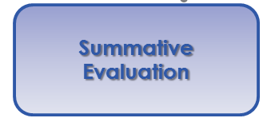
Key Change #3: Continuous Learning
Five Step Evaluation System Cycle
Self-Assessment
Analysis, goal-setting & plan development
Implementation of the plan
Formative Assessment/Evaluation
Summative Evaluation
Notes:
5-Step cycle for all educators in licensed positions
11

Slide 12
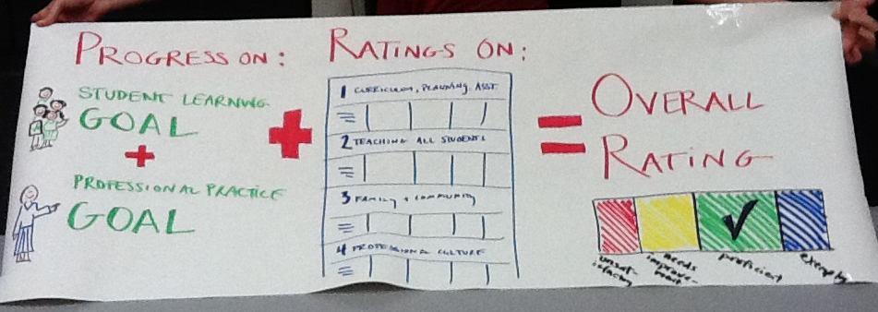
The Overall Rating
At least one SL and one PP goal
+
Ratings on the Four Standards of the Rubric
Notes:
Overview of session
12

Slide 13
Today’s Agenda
Welcome & Overview
The District Context
  Self-Assessment
  Proposing Goals
  Action Plan
  Development
  Q & A
Notes:
Overview of session
13

Slide 14
Your Context
District
District-level Data Trend
School
School-level Data Trends
Team
Previous/current year Data Trends
WSIP and School Priority Areas
District Priority Areas
Areas of Strength/Growth
Individual
Student Data
Areas of Strength/Growth
Notes:
What surprised you?
How did the rubric work?
What are some of the behaviors you came up with?

Slide 15
District priorities reflected in the rubric:
Your school may identify other priority elements that reflect your school goals.
District Priority | Element of rubric
Professional Growth and Evaluation | Goal Setting (IV-A-2)
Using Data to Differentiate Instruction | Adjustments to Practice (I-B-2) Access to Knowledge (II-D-3)
Increasing Academic Rigor | Well-Structured Lessons (I-A-4)
Engaging Families, Community and Partners | Parent/Family Engagement (III-A-1) and Two-Way Communication (III-C-1)
Notes:
9.15 -9.25
This slide shows district priorities (with corresponding priority elements) ask participants to share current practices in their school which are linked to these priorities
Notes: Priority elements reflect academic priorities, and PD and supports will be provided around these elements. These elements should be used in making decisions relative to an overall rating on a standard. Other elements may also be used that are relative to a school / team goals when rating a standard.
Use these priority elements when helping people to plan to do their self-assessment.
The Acceleration Agenda should guide school goals and targets and should guide team and individual goals and targets. Professional Practice goals should be related to the priority elements on the rubric.
They should reflect in groups about this question on the bottom of the screen.
The district has 4 priorities :
data analysis
common core standards
differentiated instruction ---- there is a mistake in the slide. Note that participants should cross off cultural proficiency and instead write “differentiated instruction.”
teacher effectiveness

Slide 16
Today’s Agenda
Welcome & Overview
The District Context
  Self-Assessment
  Proposing Goals
  Action Plan Development
  Q & A
Notes:
Overview of session
16

Slide 17
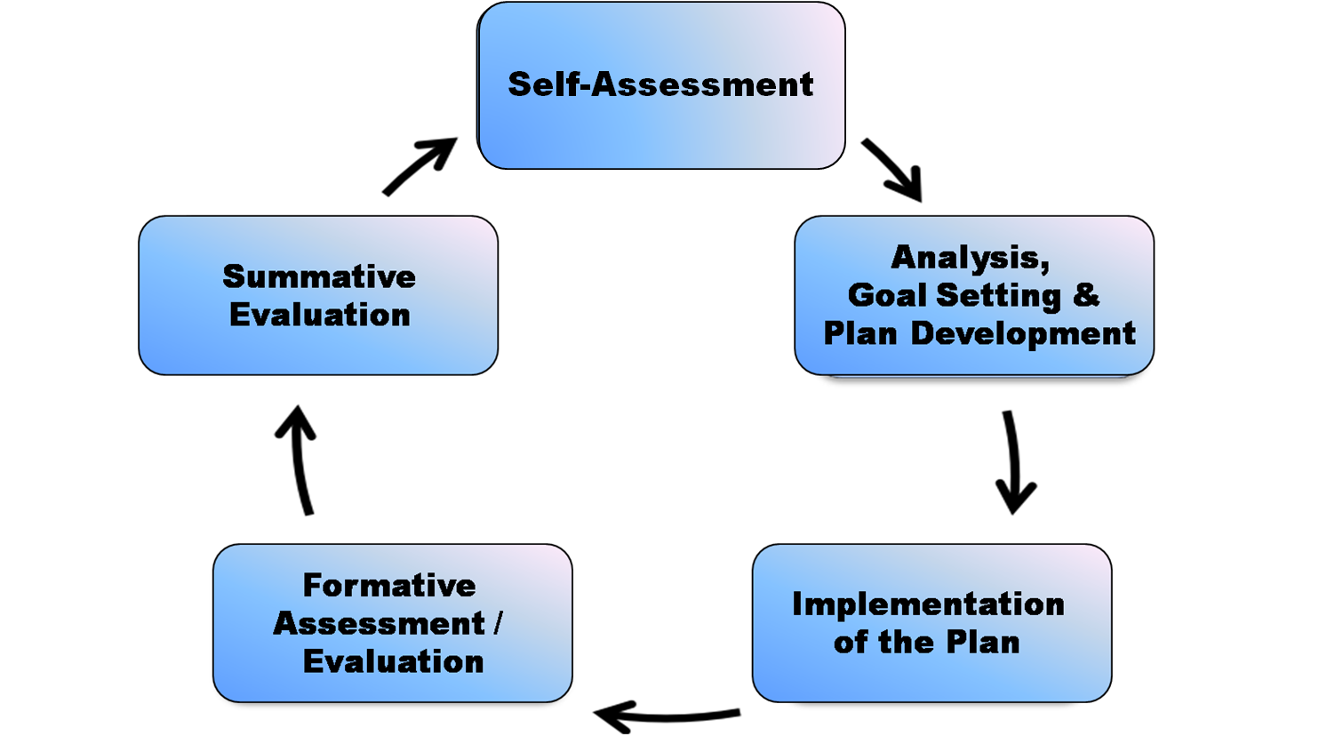
Every educator is an active participant in the evaluation process
Every educator conducts an assessment of practice against Performance Standards.
Every educator conducts an analysis of evidence of student learning, growth, and achievement
Continuous
Learning
Prepares to strategically identify professional practice and student learning goals.
Collaboration and Continuous Learning are the focus
Notes:
establishes a continuous improvement plan for every educator
promotes professional growth and continuous learning
keeps student learning at the core of all instructional and professional practice decisions
accelerates and builds upon work by supporting a through-line of goals informed by district and school goals
builds consistency across the school and district
17

Slide 18
Self-Assessment Components:
An analysis of evidence of student learning, growth, and achievement for students under the educator's responsibility;
An assessment of practice against the Performance Standards outlined in the Rubric; and
Proposed goal topics.
18
Notes:
Explain:
“Educators can start their self-assessment at the end of the previous school year and/or at the very beginning of the new school year, keeping in mind that some data won’t be available until the beginning of the new school year.
“One component of a comprehensive self-assessment calls for educators to conduct an analysis of student learning, growth and achievement.
“During this part of the self-assessment, educators collect and analyze a wide range of evidence of student learning (e.g. readiness, academic achievement, social-emotional learning) related to both their incoming students and students they have taught in the past.
“A second component of the self-assessment involves educators assessing their own professional practice against the Standards and Indicators of Effective Teaching Practice and/or Administrative Leadership, as outlined in the rubrics. Educators identify performance standards, indicators and even behaviors from the rubric where they excel, as well as areas where they need to improve their practice in order to facilitate student learning.
“Finally, based on this analysis of student learning and assessment of practice against Performance Standards, each educator proposes goals.”

Slide 19
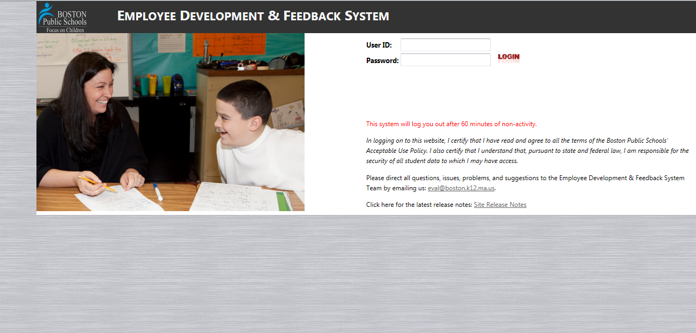
Self-Assessment on the EDFS Online System
Notes:
Note: Fix slide so there’s a link to the EDFS

Slide 20
Best Practice for the District

Slide 21
A Look at Ben’s School
School Demographics
MCAS 3rd Grade Reading
School Priority Areas
I-A-1 - Sound knowledge and understanding of subject matter and necessary pedagogy to promote complex knowledge and skills.
II-A-1 - High expectations for quality of student work and work perseverance.

Slide 22

Today’s Agenda
Welcome & Overview
The District Context
  Self-Assessment
  Proposing Goals
  Action Plan Development
  Q & A
Notes:
Overview of session
22

Slide 23
Understanding Goal Setting
Where do I need to grow this year? Where do I want my students to grow this year?
Self-Assessment
Analysis, goal-setting & plan development
Implementation of the plan
Formative Assessment/Evaluation
Summative Evaluation

Slide 24
Goal Proposal Process
      Based on the educator’s self-assessment
      BEFORE setting your goals:
        Examine student data for the Student Learning goal
        Measure practice against performance standards on rubric for the Professional Practice goal
        Ensure you have considered BPS/school priorities
      Consider team or department goals
      Educator proposes; supervisor determines
Professional
Practice
Goal
District Goals
School Goals
Student
Learning
Goal
Educator Evaluation
Notes:
AIR
Review - It’s the alignment that is so critical in this first year of the educator evaluation framework and so critical to your turnaround/transformation work.

Slide 25
Attributes of a Strong Goal
Specific
Measurable
Attainable
Results-Focused
Time-bound
Remember, the key is to make sure the goal is written clearly enough so that both you and your evaluator can determine your degree of success in meeting the goal!
Notes:
Main message: Understand our target; highlight work districts have already done in this area
Facilitator
Hand out the short Lenox SMART goals document, that describes the components of a SMART goal.
Discuss each of the attributes briefly.
What does it really look like for a goal to be strategic? To be actionable?

Slide 26
Assessing Ben’s Student Learning (SL) Goal
Ben’s Student Learning goal:
Based on the fact that many of my incoming students read below grade level on the DRA-II, by June 2012, more students will increase their prediction skills to proficiency. I will measure progress based on teacher-created exams.
Ben’s Student Learning goal, REVISED:
Based on the fact that 30% of my incoming students read below grade level on the DRA-II, by June 2012, 100% of my students will increase their prediction skills on non-fiction texts to proficiency. I will measure progress based on exams created from previous years’ administrations of the DRA-II.
Notes:
Ben’s SL goal:
Based on the fact that 30% of my incoming students read below grade level on the DRA-II, by June 2012, 100% of my students will increase their prediction skills on non-fiction texts to proficiency. I will measure progress based on exams created from previous years’ administrations of the DRA-II.

Slide 27
Assessing Ben’s Professional Practice Goal
Ben’s PP goal:
In order to increase my students’ ability to make predictions I will ask my students to predict endings of stories during read alouds.
Ben’s Professional Practice goal, REVISED:
In order to increase my students’ ability to make predictions based on text, once a week I will incorporate text-based prediction questions for my students during a read aloud.
Notes:
Ben’s PP goal:
In order to increase my students’ ability to make predictions based on text, once a week I will incorporate text-based prediction questions for my students during a read aloud

Slide 28
Let’s back up to your own self-assessment process
Complete your Self-Assessment Worksheet in order to get to GOAL TOPICS.
Remember: GOAL TOPICS are different than actual GOALS …
GOAL TOPICS are broad categories of things you might work on:
Reading comprehension
Text-based predictions
Writing in math
Notes:
Ben’s PP goal:
In order to increase my students’ ability to make predictions based on text, once a week I will incorporate text-based prediction questions for my students during a read aloud

Slide 29
Submitting Ben’s Goals on the EDFS Online System

Slide 30
Resources for Writing Goals
Guide 5: Writing Goals on the website
Templates for both SL and PP goals
Goals exemplars on the website
DESE Guidance on Making a Goal SMARTer
Notes:
Main message: Understand our target; highlight work districts have already done in this area
Facilitator
Hand out the short Lenox SMART goals document, that describes the components of a SMART goal.
Discuss each of the attributes briefly.
What does it really look like for a goal to be strategic? To be actionable?

Slide 31
Activity 3: Writing Goals
Preparation for Writing Goals:
Choose one professional practice goal topic that ideally reflects what you know about your school priorities OR the BPS district priorities.
Get messy – draft a potential professional practice goal.

Slide 32
Writing your Goals
Modeling Goal-Writing Workshop

Slide 33
Today’s Agenda
Welcome & Overview
The District Context
  Self-Assessment
  Proposing Goals
  Action Plan Development
  Q & A
Notes:
Overview of session
33

Slide 34
Action Plan Development
  After the evaluator approves the educator’s goals, they will work with each other to develop an action plan that will detail what steps need to be taken to accomplish the educator’s goals.
  Developing the plan together encourages conversations that build relationships and a shared understanding of high quality professional practice.
Notes:
34

Slide 35
Developing an Action Plan
  Using the Action Plan Development Worksheet as a guide, work with a partner to develop an Action Plan to support a professional practice goal that one of you developed from the previous SMART goal activity.
  After you have finished, talk with your partner about whether this action plan would make it highly likely that the accompanying student learning goal (from the previous SMART goal activity) could be achieved.
Notes:
35

Slide 36
Developing an Action Plan
When you have a draft of your goal and your action plan, check to see …
if the action plan reinforces the SMARTness of the goal, and
that the Professional Practice goal makes it likely that the Student Learning goal will get accomplished.

Slide 37
Today’s Agenda
Welcome & Overview
The District Context
  Self-Assessment
  Proposing Goals
  Action Plan Development
  Q & A
Notes:
Overview of session
37

Slide 38
Resources, Support, Questions, and Feedback
For more information, visit:
  http://connect.mybps.org/groups/effectiveteaching/
  http://educatoreffectiveness.weebly.com
Email questions, comments and feedback to:
  bpsevaluation@boston.k12.ma.us
MA Department of Elementary and Secondary Education (DESE) Evaluation Site:
  http://doe.mass.edu/edeval/

Slide 39
Have we met our goals today?
Begin to engage with the main elements of the new educator evaluation online system, the EDFS;
Gain insight into the role of self-assessment in the evaluation process and be able to begin assessing your own practice;
Learn the purpose of SMART goal setting and begin to draft your own goals;
Begin to draft an Action Plan;
Become aware of next steps and resources
Notes:
Intended outcomes for today
Continued support throughout the year
39

Slide 40
Plus/Deltas for Today
+ | Δ
What did you learn today? What contributed to your learning? | What would you like to have changed about today’s session? What distracted from your learning?
Notes:
*We are going to continue these trainings at other schools and would like to improve on our practice
Hand out notecards, have teachers write their individual plus/deltas on those, then ask for some share out

