Slide 1

Supporting Effective Teaching:
An Introduction to Educator Performance Evaluation
Introduction to Educator Performance Evaluation
100 Level Training for Educators

Slide 2
Today’s Agenda
Welcome & Building Context
  Overview & Key Elements
  The Rubric of Effective Teaching
  Educator Plans & Ratings
  The 5-Step Cycle: Self-Assessment
  The 5-Step Cycle: Proposing Goals
Next Steps
Notes:
Overview of session
2

Slide 3
Looking back and looking forward…
Looking back…
What has your experience with the previous evaluation process been like?
Looking forward…
What have you heard about the new educator evaluation system?
What do you want to know?
What are your hopes and fears for this new process?
Notes:
Pair Share with a Partner.
Share a couple out to the group.
3

Slide 4

BPS’ Hopes for the New Educator Evaluation System
It will improve student learning and growth in Boston Public Schools
It will set a high bar for professional teaching status
It will give teachers a stronger voice in evaluation processes
It will recognize excellence in teaching and leading
It will increase conversation about knowledge of, and practice of, effective teaching in schools.
Notes:
Add any other hopes that were mentioned earlier

Slide 5

Objectives for today
If we have done our job today, you will understand the components of the new educator evaluation process:
The 4 standards of the Rubric of Effective Teaching
The types of educator ratings and growth plans
The 5-step cycle
  Self-assessment
  Goal setting
  Implementing the plan
  Formative assessment
  Summative assessment
Notes:
Intended outcomes for today
Continued support throughout the year

Slide 6
Norms
How can we, as a team of adults looking to support and help children learn, work together most effectively today?
  Respect diversity of perspectives
  Engage in active listening
  Assume best intentions
  Provide safety and confidentiality
  Know that there are “no dumb questions”
  Others?
Notes:
6

Slide 7
Introductions: Turn and Talk
Name
School
Why you signed up for this session
Notes:
Introduce yourself to someone nearby who you don’t know
Facilitators introduce themselves
7

Slide 8
Transition to the New Performance Evaluation
Implementation plans are informed by lessons from the Turnaround Schools' experience last year
We will provide the plans for how previous evaluation ratings translate to this year’s growth plans
There will be at least 10 hours of in-service training on how performance evaluation supports the district’s academic priority areas:
Boston Public Schools Academic Priority Areas
Teacher Effectiveness | Data Use and Inquiry | Massachusetts Curriculum Frameworks | Differentiation
Notes:
This new system will help clarify and define what is effective teaching in BPS
This new system will help BPS focus and provide better support for effective teaching so that student learning results improve
You will receive the training and support you need to make the most of the new evaluation process
You will share your questions, comments, feedback, and suggestions with us, throughout the year
8

Slide 9

The Educator Evaluation System: Our Context
National shift with Race to the Top to implement new performance evaluation system
Dept. of Elementary and Secondary Education’s Regulations on Performance Evaluations
Developing common expectations through rubrics
Notes:
National shift with RTTT
Implications for level 4 districts with eval this year – all BPS schools

Slide 10
Today’s Agenda
Welcome & Building Context
  Overview & Key Elements
  The Rubric of Effective Teaching
  Educator Plans & Ratings
  The 5-Step Cycle: Self-Assessment
  The 5-Step Cycle: Proposing Goals
Next Steps
Notes:
Overview of session
10

Slide 11
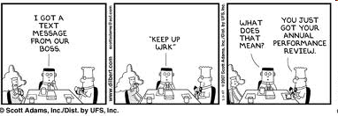
Overview: New Evaluation System
Performance evaluation systems typically have numerous flaws
What’s new?
  Rubric for Effective Teaching with 4 Performance Levels
  Five Step Cycle For Evaluation
Notes:
Many educator evaluation systems can start to look like this
This is not the fault of the teacher or evaluator – usually a result of flaws within the system itself
The new evaluation system seeks to fix these flaws
What’s new – 3 key elements
11

Slide 12
Key Change #1:
Rubric for Effective Teaching with 4 Standards
Former Teacher Evaluation (8 Dimensions)
Equity and High Expectations Professionalism Safe, Respectful, Culturally Sensitive and Responsive Learning Communities Partnership with Family and Community Instructional Planning and Implementation: Content Knowledge Monitoring and Assessment of Progress Reflection, Collaboration, and Personal Growth
New Teacher Evaluation (4 Standards)
*Curriculum, Planning & Assessment *Teaching All Students Family & Community Engagement Professional Culture
New Principal/Admin Evaluation (4 Standards)
*Instructional Leadership Management and Operations Family & Community Partnerships Professional Culture
Notes:
*Denotes priority standard(s) on which to focus.
Educators must be rated proficient on these standards in order to earn an overall performance rating of proficient.

Slide 13
Key Change #2: 4 Rating Categories,
4 Educator Growth Plans
Former categories
Does not meet standards | Does meet standards
Proficient
New categories
Fully and consistently meets the requirements of a standard
Unsatisfactory | Needs Improvement | Proficient | Exemplary
Notes:
Enables us to see variation
Enables us to see excellence: Depends on the way you use these categories
Note: Needs improvement is still within “meets standard”

Slide 14
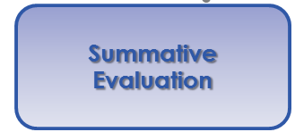
Key Change #3: 5-Step Cycle,
Continuous Learning
Self-Assessment
Analysis, goal-setting & plan development
Implementation of the plan
Formative Assessment/Evaluation
Summative Evaluation
Notes:
5-Step cycle for all educators in licensed positions
14

Slide 15
Today’s Agenda
Welcome & Building Context
  Overview & Key Elements
  The Rubric of Effective Teaching
  Educator Plans & Ratings
  The 5-Step Cycle: Self-Assessment
  The 5-Step Cycle: Proposing Goals
Next Steps
Notes:
Overview of session
15

Slide 16
Key Change #1:
Rubric for Effective Teaching with 4 Standards
New Teacher Evaluation (4 Standards)
*Curriculum, Planning & Assessment *Teaching All Students Family & Community Engagement Professional Culture
Notes:
* Denotes priority standard(s) on which to focus.
Educators must be rated proficient on these standards in order to earn an overall performance rating of proficient.

Slide 17
Teacher Rubric At-A-Glance
Standard I: Curriculum, Planning, and Assessment | Standard II: Teaching All Students | Standard III: Family and Community Engagement | Standard IV: Professional Culture
A. Curriculum and Planning Indicator Subject Matter Knowledge Child and Adolescent Development Rigorous Standards-Based Design Well-Structured Lessons | A. Instruction Indicator Quality of Effort and Work Student Engagement Meeting Diverse Needs | A. Engagement Indicator Parent/Family Engagement | A. Reflection Indicator Reflective Practice Goal Setting B. Professional Growth Indicator Professional Learning and Growth
B. Assessment Indicator Variety of Assessment Methods Adjustments to Practice | B. Assessment Indicator Safe Learning Environment Collaborative Learning Environment Student Motivation | B. Assessment Indicator Learning Expectations Curriculum Support | C. Collaboration Indicator Professional Collaboration
C. Analysis Indicator Analysis and Conclusions Sharing Conclusions With Colleagues Sharing Conclusions With Students | C. Analysis Indicator Respects Differences Maintains Respectful Environment | C. Analysis Indicator Two-Way Communication Culturally Proficient Communication | D. Decision-making Indicator Decision-making E. Shared Responsibility Indicator Shared Responsibility
 | D. Expectations Indicator Clear Expectations High Expectations Access to Knowledge |  | F. Professional Responsibility Indicator Judgment Reliability and Responsibility
Notes:
There are 4 standards and 37 indicators
Can see better on the rubric handout

Slide 18
Standard
Indicator
Element
Notes:
Standards I through IV
Indicators for each standard
Sub-indicators/Dimensions for each indicator
Performance levels articulated
Developmental v. degree?

Slide 19
The purpose of a Rubric of Effective Teaching:
Develop a consistent, shared understanding of what proficient performance looks like in practice.
Develop a common terminology and structure to organize evidence.
Make informed professional judgments about formative and summative performance ratings on each standard and overall.
The rubric is NOT a classroom observation tool
Notes:
Used for:
self-assessment, generating goals, observing practice, deepen shared knowledge of proficient practice
Schools will prioritize certain sections of the rubric
Educators will be rated along each standard

Slide 20
Activity 1: Using the Rubric
Each table selects one of the three elements
Silently read through each of the performance levels for that element
Underline key changes in the language for each performance level
Pair up and compare your notes
Notes:
Before activity:
What standard are we looking at? Indicator? Element?
After activity:
What surprised you?
How did the rubric work?

Slide 21
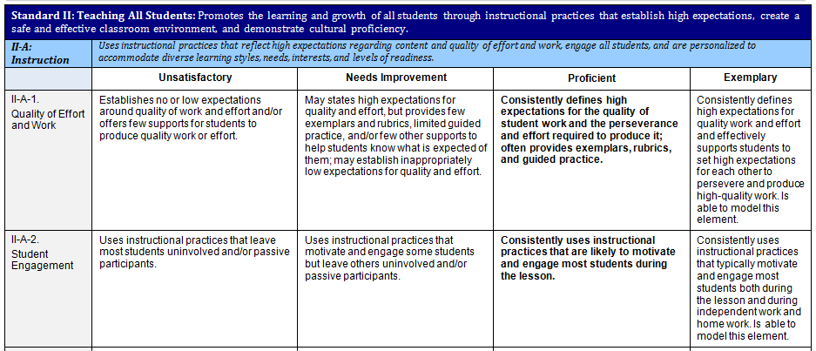
Activity 1: Using the Rubric

Slide 22
Today’s Agenda
Welcome & Building Context
  Overview & Key Elements
  The Rubric of Effective Teaching
  Educator Plans & Ratings
  The 5-Step Cycle: Self-Assessment
  The 5-Step Cycle: Proposing Goals
Next Steps
Notes:
Overview of session
22

Slide 23
Key Change #2: 4 Rating Categories,
4 Educator Growth Plans
Former categories
Does not meet standards | Does meet standards
New categories
Unsatisfactory | Needs Improvement | Proficient | Exemplary
Notes:
Enables us to see variation
Enables us to see excellence: Depends on the way you use these categories
Note: Needs improvement is still within “meets standard”

Slide 24
Educator plans are determined by performance rating and career stage
  Ratings
  Educator Plans
  PTS educators
  Non-PTS educators
Exemplary
Self-Directed Growth Plan
Developing Educator Plan
Proficient
Needs Improvement
Directed-Growth Plan
Unsatisfactory
Improvement Plan

Slide 25
Transition year: educator plan is determined by previous performance rating and career stage
  Ratings
  Educator Plans
  PTS educators
  Non-PTS educators
Self-Directed Growth Plan
Developing Educator Plan
Teachers With Overall “Meets Standard”
Teachers With 1 Overall “Does Not Meet Standard”
Directed-Growth Plan
Teachers With 2+ Overall “Does Not Meets”
Improvement Plan

Slide 26
  How Different Types of Educator Plans are Developed
  Self-directed Growth Plan:
  Goals & action plan developed by the educator, approved by the evaluator
  Directed Growth Plan:
  Goals & action plan co-created by the educator and evaluator
  Improvement Plan:
  Goals & action plan developed by the evaluator with goals specific to improving the educator’s performance
  Developing Educator Plan:
  Goals & action plan co-created by the educator and the evaluator
Notes:
Ratings are “overall rating”
26

Slide 27
Today’s Agenda
Welcome & Building Context
  Overview & Key Elements
  The Rubric of Effective Teaching
  Educator Plans & Ratings
  The 5-Step Cycle: Self-Assessment
  The 5-Step Cycle: Proposing Goals
Next Steps
Notes:
Overview of session
27

Slide 28
Understanding Self-Assessment
What are my strengths and areas for development?
Self-Assessment
Analysis, goal-setting & plan development
Implementation of the plan
Formative Assessment/Evaluation
Summative Evaluation
Notes:
Self assessment consists of analysis of professional practice against the rubrics and analysis of student performance as well as teacher impact

Slide 29
Activity 2: Self-Assessment Activity
Review the recent school data
Read through the school priority elements. Reflect on your own practice in the classroom as you read.
Ask yourself:
  How does my own practice reflect the expectations in these elements?
  How would I rate my own performance on each element?
  What evidence would I cite to back these ratings up?
On a piece of paper, record the evidence that you would cite for your performance on each element.
Notes:
What behaviors do I exhibit?
Individual Activity

Slide 30
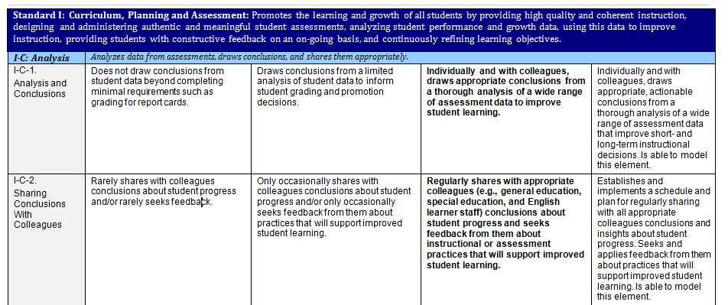
Activity 2: Self-Assessment

Slide 31
Today’s Agenda
Welcome & Building Context
  Overview & Key Elements
  The Rubric of Effective Teaching
  Educator Plans & Ratings
  The 5-Step Cycle: Self-Assessment
  The 5-Step Cycle: Proposing Goals
Next Steps
Notes:
Overview of session
31

Slide 32
Understanding Goal Setting
Where do I need to grow this year? Where do I want my students to grow this year?
Self-Assessment
Analysis, goal-setting & plan development
Implementation of the plan
Formative Assessment/Evaluation
Summative Evaluation

Slide 33
Goals and Ratings
Progress on Ratings on Overalll
(2) Goals (4) Standards Rating
Student Learning
Professional
Practice
Curriculum, Planning and Assessment
Teaching All Students
Family & Community Engagement
Professional Culture
Exemplary
Proficient
Needs Improvement
Unsatisfactory

Slide 34
Proposing and Setting Goals
Rationale for goal-setting
Based on the educator’s self-assessment
  At least:
  One goal for student learning, growth and achievement, and
  One goal for professional practice
Consider team, grade, or department goals
Educator proposes; supervisor determines
Notes:
Educators will be pursuing at least one goal related to their professional practice as well as at least one directly related to student learning.
Educators and their evaluators consider team goals. We think team goals – in the hands of proficient and exemplary teachers and administrators especially – will help support and sustain the professional learning communities that research increasingly tells us are critical to continuous improvement at both the individual and school level.
Ultimately, under the regulations, the evaluator makes the call as to the goals the educator pursues

Slide 35
Goals must be aligned with:
District Priorities:
Embedded throughout the rubric
School Priorities:
based on district priorities
supported with data ( WSIP )
Self Assessment:
Due October 1st
Educator Goal Setting
Student Learning and Professional Practice
Notes:
Educators will be pursuing at least one goal related to their professional practice as well as at least one directly related to student learning.
Educators and their evaluators consider team goals. We think team goals – in the hands of proficient and exemplary teachers and administrators especially – will help support and sustain the professional learning communities that research increasingly tells us are critical to continuous improvement at both the individual and school level.
Ultimately, under the regulations, the evaluator makes the call as to the goals the educator pursues

Slide 36
Goal Proposal Process
      Create at least (1) Professional Practice Goal and at least (1) Student Learning Goal
      Consider team or department goals
        For example, the fifth grade team has a (SL) goal and ea. teacher has their own(PP) goal.
      BEFORE setting your goals:
        Examine student data for the Student Learning goal
        Measure practice against performance standards on rubric for the Professional Practice goal
Student
Learning
Goal
Professional
Practice
Goal
District Goals
School Goals
Professional Practice Goal
Student Learning Goal
Educator Evaluation
Notes:
AIR
Review - It’s the alignment that is so critical in this first year of the educator evaluation framework and so critical to your turnaround/transformation work.

Slide 37
Attributes of a Strong Goal
Specific
Measurable
Attainable
Results-Focused
Time-bound
Remember, the key is to make sure the goal is written clearly enough so that both you and your evaluator can determine your degree of success in meeting the goal!
Notes:
Main message: Understand our target; highlight work districts have already done in this area
Facilitator
Hand out the short Lenox SMART goals document, that describes the components of a SMART goal.
Discuss each of the attributes briefly.
What does it really look like for a goal to be strategic? To be actionable?

Slide 38
Activity 3: Analyzing & Re-writing Goals
At your table, review each of the goals in the “Analyzing Goals” worksheet.
Identify whether the goal is a Professional Practice (PP) goal or a Student Learning (SL) goal.
Consider the criteria for a SMART goal. Based on how each goal is written, rate how SMART you think it is.
Pick at least two goals that you rated a 1 or a 2 and discuss with your table-mates how you might rewrite the goal to be a SMARTER goal.

Slide 39
Today’s Agenda
Welcome & Building Context
Overview & Key Elements
  The Rubric of Effective Teaching
  Educator Plans & Ratings
  The 5-Step Cycle: Self-Assessment
  The 5-Step Cycle: Proposing Goals
  Next Steps
Notes:
Overview of session
39

Slide 40
A Culture of Continuous Learning
Self-Assessment
Analysis, goal-setting & plan development
Implementation of the plan
Formative Assessment/Evaluation
Summative Evaluation
What will I do to achieve this growth for myself and my students?
Notes:
So, now that you have—at the beginning of the school year—completed your self-assessment and developed your goals, I am going to tell you about what happens the rest of the year.
Well, then…you are in your classroom teaching your students throughout the year. As you do so, you want to be thinking about:
Your Educator Plan—what are the goals outlined in it. How are you making progress on those goals? What evidence are you gathering to demonstrate your progress on those goals?
The four standards of practice—in addition to what your goals are in your plan, pay attention to the four standards. How are you making progress within each of the four standards? What evidence are you gathering to demonstrate your performance level in each standard? Some—generally, the first two—are things that can and will be observed by your evaluator. Others—generally, the second two—are not. You will need to collect evidence throughout the year to demonstrate your proficiency in these two standards.
Collection of evidence / observations / parent teacher feedback
40

Slide 41
Implementation
Areas for Collecting Evidence
Professional Practice Goal
Student Learning Goal
4 Standards:
Teach and Collect
Evidence
Curriculum, Planning and Assessment
Teaching All Students
Family & Community Engagement
Professional Culture
Action Plan
Goals

Slide 42
A Culture of Continuous Learning
How did I do this cycle?
What should I work on next?
Self-Assessment
Analysis, goal-setting & plan development
Implementation of the plan
Formative Assessment/Evaluation
Summative Evaluation
How am I doing in relation to my goals?

Slide 43
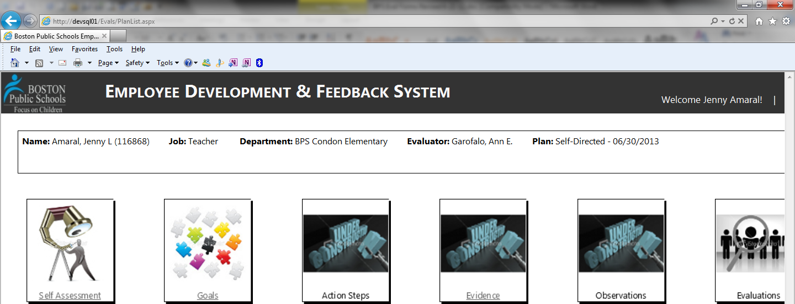
Employee Development & Feedback System (EDFS)

Slide 44
Preparing for the school year
Become familiar with the rubric and think about how it relates to your practice.
Begin to think about goals that would be appropriate.
When you are assigned your students, analyze their data and think about student learning goals.
As a staff, think about how you might build in team goals and collaborative structures to focus on priority areas.
Participate and stay engaged with us. Talk with colleagues, talk to your principals, ask questions.

Slide 45
Resources, Support, Questions, and Feedback
For more information, visit:
  http://connect.mybps.org/groups/effectiveteaching/
Email questions, comments and feedback to:
  bpsevaluation@boston.k12.ma.us
MA Department of Elementary and Secondary Education (DESE) Evaluation Site:
  http://doe.mass.edu/edeval/
Angela Rubenstein Kris Taylor
  arubenstein@boston.k12.ma.us ktaylor2@boston.k12.ma.us

Slide 46
Have we met our goals for today?
Understand the components of the new educator evaluation process:
The 4 standards of the Rubric of Effective Teaching
The types of educator ratings and growth plans
The 5-step cycle
  Self-assessment
  Goal setting
  Implementing the plan
  Formative assessment
  Summative assessment
Notes:
Intended outcomes for today
Continued support throughout the year

Slide 47
Plus/Deltas for Today
+ | Δ
What did you learn today? What contributed to your learning? | What would you like to have changed about today’s session? What distracted from your learning?

