Slide 1

Leveraging Performance Management to District and Departmental Priorities
Professional Development for CENTRAL OFFICE
EDUCATORS & evaluators
OCTOBER, 2012

Slide 2
Today’s Agenda
Overview of the five-step cycle and contract language
How the online Employee Development & Feedback System (EDFS) helps the evaluator manage the evaluation cycle
Understanding the rubric and priority elements
Resources
Self-assessment and goals proposal
Notes:
Goal 1: Central Office evaluators AND educators will understand the key features of the new evaluation system: 5-step cycle, effectiveness rubrics with 4 levels of performance, evidence based on multiple measures
Goal 2:
Central Office educators will leave with knowledge and tools to be able to complete their self-assessments and propose goals by the deadline.
Central Office evaluators will leave with the knowledge and tools to be able to review and provide feedback on educators’ goals.
Goal 3:
Central Office evaluators and educators will understand the basic functions of the new online evaluation system (the Educator Development & Feedback (EDFS) system) and:
Evaluators will leave knowing how to activate educators’ plans and review and/or approve goals
Educators will leave knowing how to access the EDFS and complete their self-assessments and propose goals.

Slide 3
The new evaluation system:
Empowers every educator to take ownership of their evaluation
Promotes growth and development
Places student learning at the center
Recognizes excellence
Sets a high bar for tenure
Shortens timelines for improvement
Aligns evaluations of every educator in the system
→ Can be a focal point from which to leverage other academic, departmental, or district priorities

Slide 4
Leveraging Performance Evaluations
How can BPS use this…
and achieve the AA Goals?
to be successful in:
Engaging Families, Students & Partners
Graduate all students from high school prepared for college completion and career success
Professional Growth and Evaluation
Using Data to Differentiate Instruction
Close access and achievement gaps
Educator Performance Evaluation
Increasing Academic Rigor
Ensure all students achieve MCAS proficiency

Slide 5
Overview
4 Standards
Former Teacher Evaluation (8 Dimensions)
Equity and High Expectations Professionalism Safe, Respectful, Culturally Sensitive and Responsive Learning Communities Partnership with Family and Community Instructional Planning and Implementation: Content Knowledge Monitoring and Assessment of Progress Reflection, Collaboration, and Personal Growth
New Teacher Evaluation (4 Standards)
*Curriculum, Planning & Assessment *Teaching All Students Family & Community Engagement Professional Culture

Slide 6
Standards for Effective Teaching & School/District Leadership
New Teacher Standards
*Curriculum, Planning & Assessment *Teaching All Students Family & Community Engagement Professional Culture
New Principal/Admin Standards
*Instructional Leadership Management and Operations Family & Community Partnerships Professional Culture

Slide 7
4 rating categories
Former categories
Does not meet standards | Does meet standards
New categories
Unsatisfactory | Needs Improvement | Proficient | Exemplary
Notes:
Proficient =Fully and consistently meets the requirements of a standard

Slide 8
Teacher Rubric At-A-Glance
Standard I: Curriculum, Planning, and Assessment | Standard II: Teaching All Students | Standard III: Family and Community Engagement | Standard IV: Professional Culture
A. Curriculum and Planning Indicator Subject Matter Knowledge Child and Adolescent Development Rigorous Standards-Based Design Well-Structured Lessons | A. Instruction Indicator Quality of Effort and Work Student Engagement Meeting Diverse Needs | A. Engagement Indicator Parent/Family Engagement | A. Reflection Indicator Reflective Practice Goal Setting B. Professional Growth Indicator Professional Learning and Growth
B. Assessment Indicator Variety of Assessment Methods Adjustments to Practice | B. Assessment Indicator Safe Learning Environment Collaborative Learning Environment Student Motivation | B. Assessment Indicator Learning Expectations Curriculum Support | C. Collaboration Indicator Professional Collaboration
C. Analysis Indicator Analysis and Conclusions Sharing Conclusions With Colleagues Sharing Conclusions With Students | C. Analysis Indicator Respects Differences Maintains Respectful Environment | C. Analysis Indicator Two-Way Communication Culturally Proficient Communication | D. Decision-making Indicator Decision-making E. Shared Responsibility Indicator Shared Responsibility
 | D. Expectations Indicator Clear Expectations High Expectations Access to Knowledge |  | F. Professional Responsibility Indicator Judgment Reliability and Responsibility
Notes:
2.40– 2.45
Take 5 minutes to share next 2 slides with the participants
There are 4 standards and 37 indicators

Slide 9
Standard
Indicator
Element

Slide 10
How are district priorities reflected in the rubric?
District Priority | Element of rubric
Common-core shifts | Well-Structured Lessons (I-A-4)
Data | Adjustments to Practice (I-B-2)
Educator Effectiveness | Goal Setting (IV-A-2)
Cultural Proficiency | Access to knowledge (II-D-3)
Family and Community Engagement | Parent/Family Engagement (III-A-1) and Two-way Communication (III-C-1)
→ How are existing practices in your department reflected on the rubric?

Slide 11
Overview: Five Step Evaluation System Cycle
Self-Assessment
Analysis, goal-setting, & plan development
Formative Assessment/Evaluation
Summative Evaluation
Implementation of the plan

Slide 12
School-wide goals & priorities should guide the
Five Step Evaluation System Cycle
School or Dept-wide Analysis & Goal-Setting
Self-Assessment
Analysis, goal-setting & plan development
Implementation of the plan
Formative Assessment/Evaluation
Summative Evaluation

Slide 13
Step 1: Self Assessment
Educators self-assess their performance using:
    Student data (or other relevant departmental data)
      and
    The Standards and Indicators of Effective Teaching Practice and/or Administrative Leadership
Educators propose goals related to their professional practice and student learning needs
Self-Assessment
Analysis, goal-setting, & plan development
Formative Assessment/Evaluation
Summative Evaluation
Implementation of the plan

Slide 14
Step 2: Analysis, Goal Setting, and Plan Development
Educators set at least two goals:
    Student learning goal
    (Aligned to their team’s/school’s/department’s student learning goals)
    Professional practice goal
    (Aligned to the Standards and Indicators of Effective Teaching and/or Administrative Leadership Practice)
Educators are required to consider team goals
Evaluators have final authority over goals
Self-Assessment
Analysis, goal-setting, & plan development
Formative Assessment/Evaluation
Summative Evaluation
Implementation of the plan

Slide 15
Attributes of a Strong Goal
Make sure the goal
is written clearly enough so that both you and your evaluator can determine your degree of success in meeting the goal!
Specific
Measurable
Attainable
Results-Focused
Time-bound

Slide 16
Pause for questions
Examining rubrics & self-assessing
What questions do you have up to this point?
Look over the rubrics that different central administrators will be assigned:
  How are existing practices in your department reflected in the rubric(s)
  What priorities has your department discussed?
  What seems to make the most sense to focus on for your self-assessment/goal-setting?
Draft your self-assessment and/or a professional practice goal.

Slide 17
“Step 3”: Implementation of the Plan - Educator
Educator completes the planned action steps.
Educator collects evidence relative to standards and goals.
Evaluator provides feedback on practice to educators.
Self-Assessment
Analysis, goal-setting, & plan development
Formative Assessment/Evaluation
Summative Evaluation
Implementation of the plan

Slide 18
Step 4: Formative Assessment/Evaluation
Educator submits collected data to evaluator
Evaluator summarizes data collected, coming to a formative rating on each of the four standards of professional practice and/or assessment of progress toward goals
Evaluator provides feedback to the
educator to help him or her improve
professional practice
Self-Assessment
Analysis, goal-setting, & plan development
Formative Assessment/Evaluation
Summative Evaluation
Implementation of the plan

Slide 19
Step 5: Summative Evaluation
Educator submits collected data to evaluator
Evaluator determines an overall summative rating of performance based on:
    The educator’s performance against the four performance Standards (educators receive a rating for each Standard), and
    Evidence of the attainment of goals
Educator uses summative evaluation to
inform self-assessment
Self-Assessment
Analysis, goal-setting, & plan development
Formative Assessment/Evaluation
Summative Evaluation
Implementation of the plan

Slide 20
Formative & Summative evaluations based on:
Progress on Ratings on OVERALL
(2) Goals (4) Standards RATING
* Student Learning
* Professional Practice
- Curriculum, Planning and Assessment
- Teaching All Students
- Family & Community Engagement
- Professional Culture
- Exemplary
- Proficient
- Needs Improvement
- Unsatisfactory

Slide 21
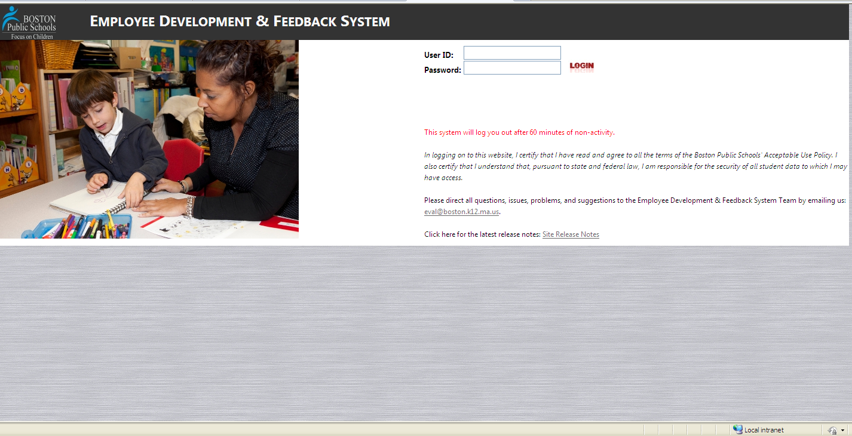
Employee Development & Feedback System

Slide 22
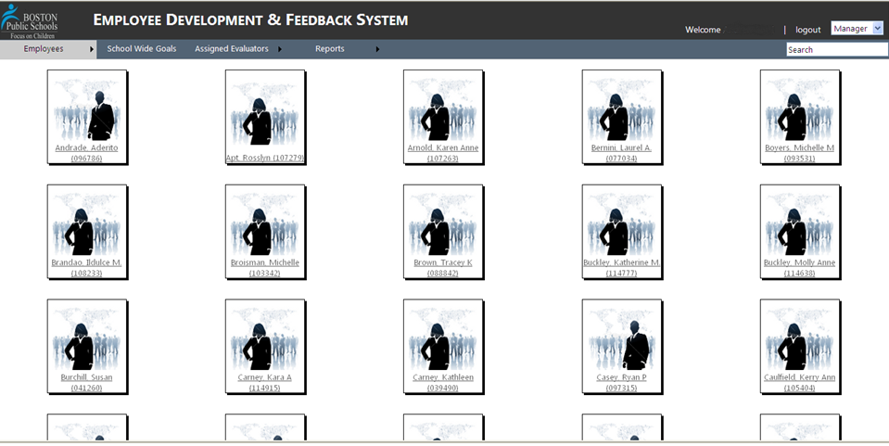
EDFS: Manager View

Slide 23
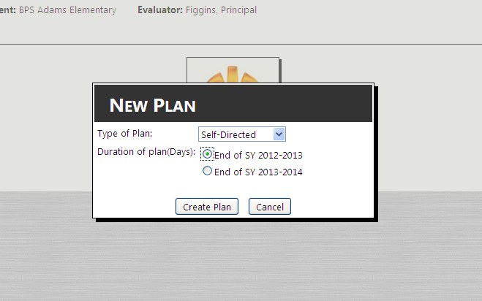
Determining the duration of a plan
Notes:
Before we start, I am going to show you the very first things you will need to know to begin this online eval system for your teachers. Then I am going to let you use the activity we passed around to practice going through the entire evaluation process for teachers.

Slide 24
Educator plan is determined by the performance rating and career stage
  Ratings
  Educator Plans
  PTS educators
  Non-PTS educators
Exemplary
Self-Directed Growth Plan
(2-year or
1-year)
Developing Educator Plan
(1 year)
Proficient
Needs Improvement
Directed-Growth Plan
(60 days-1year)
Unsatisfactory
Improvement Plan
(30 days -1 year)

Slide 25
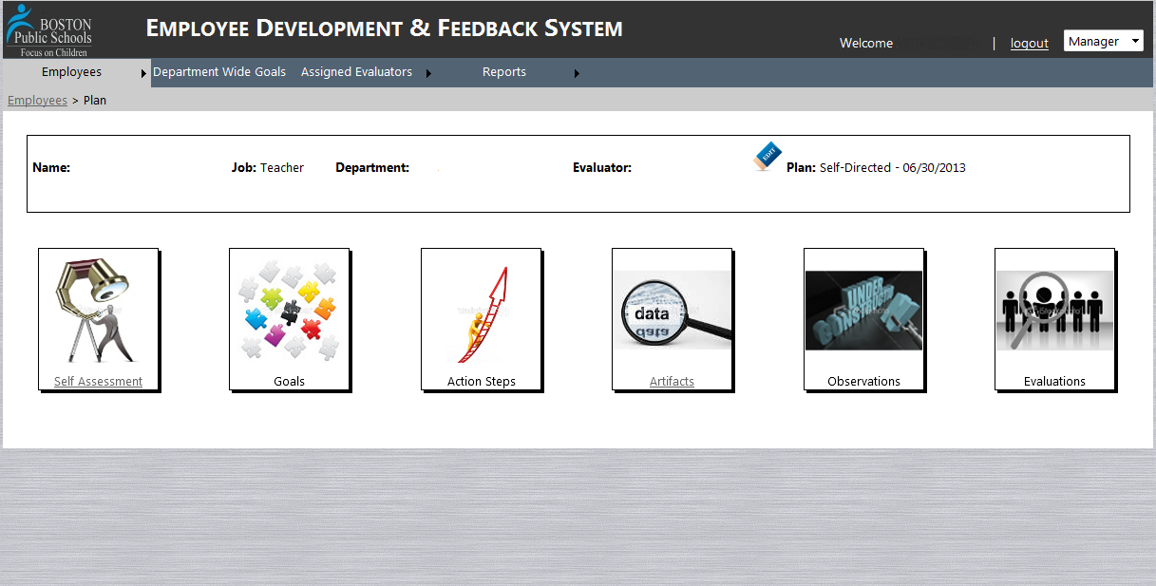
EDFS: 5-Step View

Slide 26
Time to try out EDFS
If you have a computer, try to log on to the system:
  http://eval.mybps.org/evals/
If you are an evaluator
  See who is assigned to you
  Try to activate someone (or several people)
If you are not an evaluator
  Explore the different modules. Try to input one of your self-assessments.
Practice using the training site.

Slide 27
BTU Contract Highlights
  Timelines & Observation Requirements
    Dates for educators rated proficient or exemplary
    Set minimums for # of observations
    Dates and minimums for educators on development plans
    Includes some announced observations

Slide 28
Timelines and Requirements (per BTU contract)
Type of Educator Plan
Self-Directed Growth Plan
1 school year*
Directed Growth Plan
Less than 1 school year
Announced observations
None required
None required
Unannounced observations
1
2
Improvement Plan
30 calendar days to 1 school year
Developing Educator Plan
1 school year
Required Dates
2 if plan is less than 6 months
4 if plan is between 6 months and 1 year
4
1
1
Oct. 1: Educator submits self-assessment & proposes 2 goals
Nov. 1: Evaluator completes educator plans by approving goals & action steps
May 15: Evaluator completes Summative Evaluation Report
June 1: Evaluator meets with educators whose overall Summative Evaluation ratings are moved from Proficient or Exemplary to Needs Improvement or Unsatisfactory
Dates established in educator plan.
Dates established in educator plan.
Oct. 1: Evaluator meets with 1st year educators to assist with self-assessment and goal-setting.
Other dates are same as above for 1-year Self-Directed Growth Plan.

Slide 29
Reflection
With an elbow partner, discuss:
What do these shifts mean for you and your role and department?

Slide 30
Resources, Support, Questions, and Feedback
For more information, visit:
    EDFS: http://eval.mybps.org/
    http://educatoreffectiveness.weebly.com
Email questions, comments, and feedback to:
    Bpsevaluation@boston.k12.ma.us
MA Department of Elementary and Secondary Evaluation (DESE) Evaluation Site:
    http://www.doe.mass.edu/edeval/

Slide 31

http://educatoreffectiveness.weebly.com

Slide 32
Office of Educator Effectiveness & HR Team
Ross Wilson, Asst. Superintendent for Educator Effectiveness
  OEE Team:
    Jared Joiner, Implementation Specialist
    Emily Kalejs Qazilbash, Implementation Specialist
    Angela Rubenstein, Implementation Specialist
    Kris Taylor, Implementation Specialist
    Jenna Costin, EDFS On-line System Coordinator
Ann Chan, Asst. Superintendent for Human Resources
  HR/Operations Team:
    Cheryl Kirkpatrick, Senior Advisor for Personnel Development & Strategy
    Jill Conrad, Sr. Advisor for Human Capital Strategy

